Slide 1
Synchronization

Slide 2
Why Synchronize?
Often important to control access to a single, shared resource.
Also often important to agree on the ordering of events.
Synchronization in Distributed Systems is much more difficult than in uni processor systems.
We will study:
Synchronization based on “Actual Time”.
Synchronization based on “Relative Time”.
Synchronization based on Co-ordination (with Election Algorithms).
Distributed Mutual Exclusion.
Distributed Transactions.

Slide 3
Clock Synchronization
In a centralized system, time is unambiguous.
When a process wants to know the time, it makes a system call and the kernel tells it.
If process A asks for the time. and then a little later process B asks for the time, the value that B gets will be higher than the value A got.
It will certainly not be lower.
In a distributed system, achieving agreement on time is not trivial

Slide 4
In a distributed system in which there were no global agreement on time.
Suppose that output.o has time 2144 as above, and shortly thereafter output.c is modified but is assigned time 2143 because the clock on its machine is slightly behind, as shown in Fig.
Make will not call the compiler.
The resulting executable binary program will then contain a mixture of object files from the old sources and the new sources.
It will probably crash and the programmer will go crazy trying to understand what is wrong with the code.

Slide 5
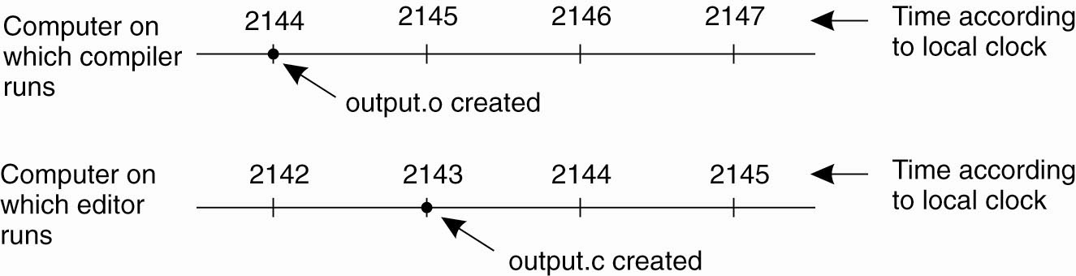
Clock Synchronization
When each machine has its own clock, an event that occurred after another event may nevertheless be assigned an earlier time

Slide 6
Clock Synchronization
Synchronization based on “Actual Time”.
Note: time is really easy on a uniprocessor system.
Achieving agreement on time in a DS is not trivial.
Question: is it even possible to synchronize all the clocks in a Distributed System?
With multiple computers, “clock skew” ensures that no two machines have the same value for the “current time”. But, how do we measure time?

Slide 7
How Do We Measure Time?
measuring time is not as easy as one might think it should be.
Algorithms based on the current time (from some Physical Clock) have been devised for use within a DS.

Slide 8
Synchronization is categorized in to 4 types
Physical clocks
Logical clocks
Mutual exclusion
Election algorithms

Slide 9
Physical clocks
Nearly all computers have a circuit for keeping track of time
Physical clocks are 3 types
Christian Algorithm
Berkley Algorithm
NTP Algorithm

Slide 10
Coordinated Universal time(UTC)
All computers are generally synchronized to a universal time called coordinated universal time(UTC)
UTC is the time standard by which world regulates clocks and time.
It is available via radio signal, telephone line, satellite(GPS)
UTC is broadcasted via the satellite
UTC broadcasting service provides an accuracy of 0.5 msec
Computer servers and online services with UTC receivers can be synchronized by satellite broadcasts
Many popular synchronization protocols in Ds

Slide 11
Use of UTC
Sometimes we need exact time not an ordering
Solution is UTC
A distributed system with a UTC receiver somewhere in it, distribute its time to each machine
Principle: every machine has a timer that generates an interrupt H times per sec

Slide 12
There is a clock in machine p that ticks on each timer interrupt
Value of the clock is denoted by cp(t), where t is UTC time
Ideally for each machine cp(t)=t or dc/dt=1
In general 1-p= dc/dt<= 1+p, where p is maximum drift rate
Never let two cocks in any system differ by more than δ time units, synchronize at least every δ/2p seconds

Slide 13
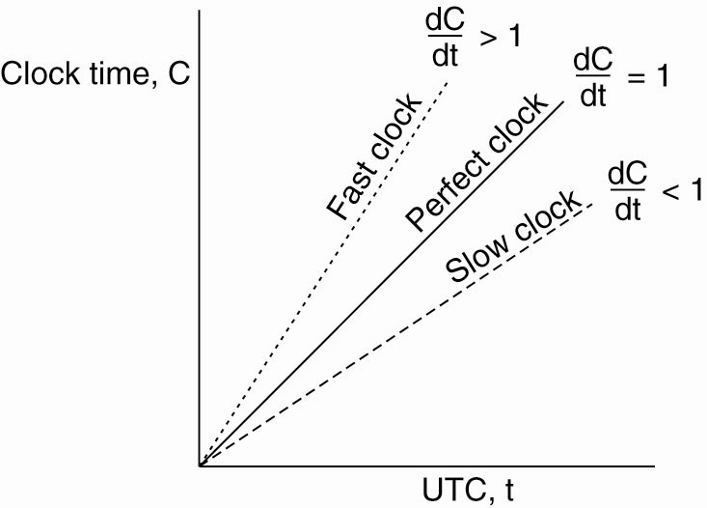
Physical Clocks (3)
The relation between clock time and UTC when clocks tick at different rates

Slide 14
Global Positioning System
The Global Positioning System (GPS) is a space-based radio navigation system
First launch -> February 1978
It is a global navigation satellite system that provides :-
Geo-location
Time information to a GPS receiver
Mainly use for clock synchronization, navigation, map making and surveying purpose

Slide 15
Basic Concept
GPS made up of a network of a minimum of 24 satellites
Its concept is based on time and the known position of specialized satellites.
The satellites carry very stable atomic clocks that are synchronized
Any drift from true time maintained on the ground is corrected daily.

Slide 16
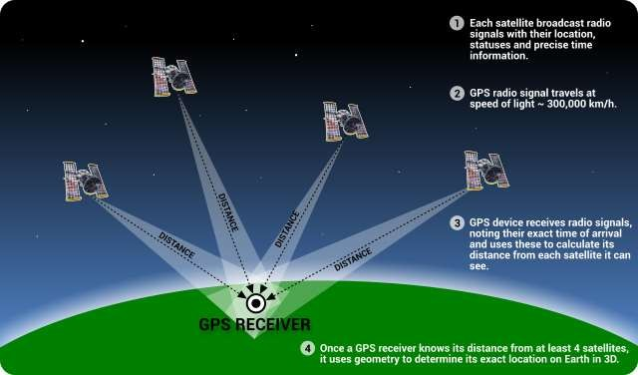
How it works

Slide 17
To calculate your 2-D position (latitude and longitude)
GPS receiver must be locked on to the signal of at least 3 satellites.
To calculate 3-D position (latitude, longitude and altitude).
GPS receiver require signals from 4 or more

Slide 18
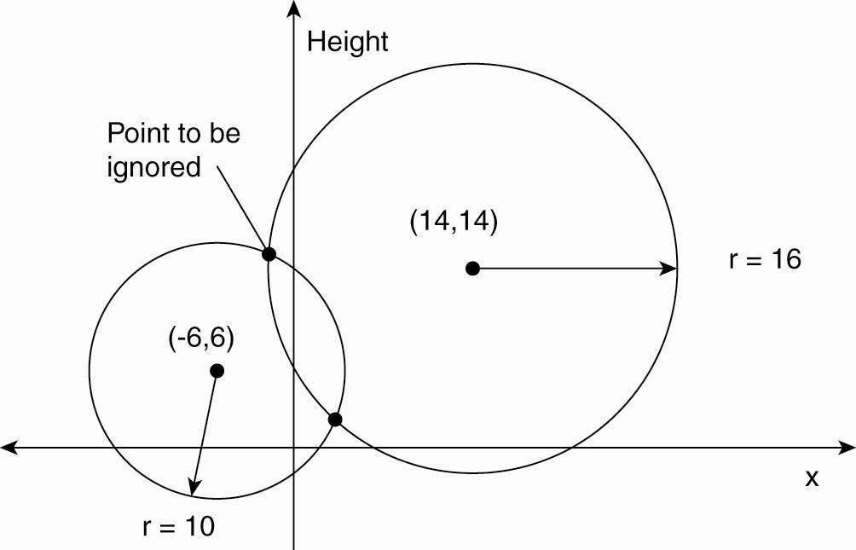
Global Positioning System (1)
Computing a position in a two-dimensional space

Slide 19
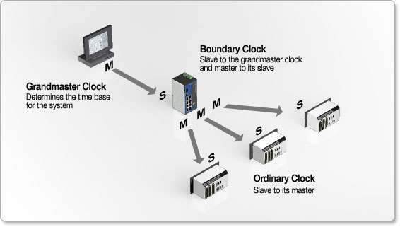
GPS based Distributed system

Slide 20
GPS based Distributed system
For GPS clock synchronization
GPS signal is received
processed by a local master clock, time server, or primary reference
passed on to "slaves" and other devices, systems, or networks

Slide 21
Features
GPS clock synchronization eliminates the need for manual clock setting
events can be correlated even when they are time stamped by different clocks
Also helps in
Resource Location
Handoffs in Wireless Networks
Email Delivery Based on Geographic Location
Peer-to-peer Routing with Limited Range Receivers

Slide 22
Global Positioning System
Real world facts that complicate GPS:
It takes a while before data on a satellite’s position reaches the receiver.
The receiver’s clock is generally not in synch with that of a satellite.

Slide 23
Cristian's Algorithm
A machine sends a request to time server in d/2 sec, where d is a maximum difference between a clock and UTC
The time server sends a reply with current UTC
The machine measures the time delay between the time server sending the message and machine receiving it
Then it uses some measure to adjust the clock

Slide 24
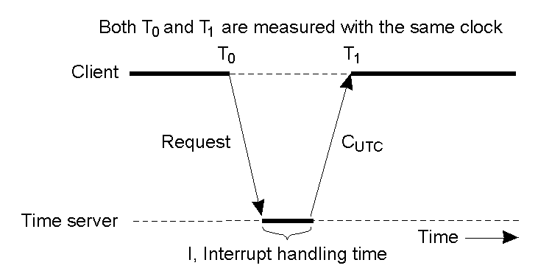

Slide 25
Best estimate of message propagation time is (T0+T1)/2
The new time can be set to the time returned by server+ time that elapsed
Tnew=T server+ (T0+T1)/2

Slide 26
Cristian's Algorithm
Getting the current time from a “time server”, using periodic client requests.
Major problem if time from time server is less than the client – resulting in time running backwards on the client! (Which cannot happen – time does not go backwards).
Minor problem results from the delay introduced by the network request/response: latency.

Slide 27
The Berkeley Algorithm
The server polls each machine periodically, asking it for the time
Based on the response, it computes the average time and tells all other machines to advance or slow down their clocks until specified time has been achieved
The time daemon’s time must be set manually by the operator periodically

Slide 28
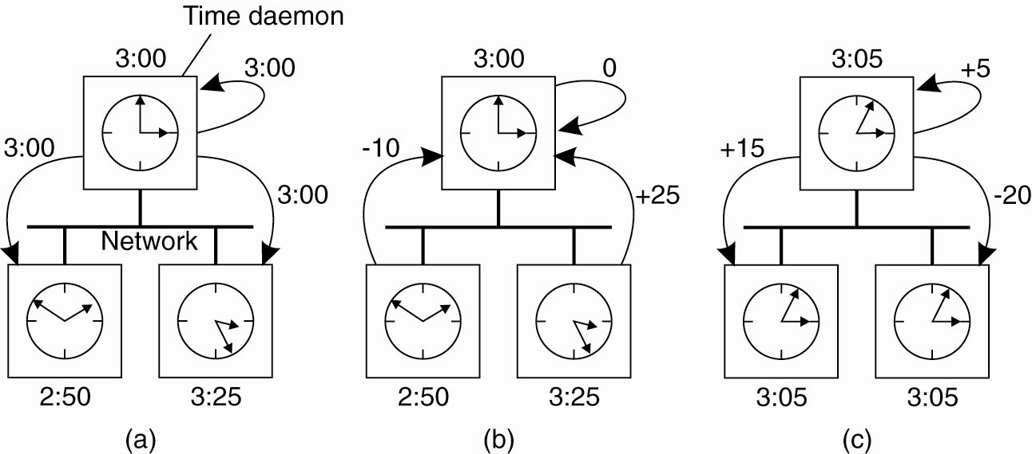
The Berkeley Algorithm (1)
(a) The time daemon asks all the other machines for their clock values

Slide 29
The Berkeley Algorithm (2)
(b) The machines answer

Slide 30
The Berkeley Algorithm (3)
(c) The time daemon tells everyone how to adjust their clock

Slide 31
Other Clock Sync. Algorithms
Both Cristian’s and the Berkeley Algorithm are centralized algorithms.
Decentralized algorithms also exist, and the Internet’s Network Time Protocol (NTP) is the best known and most widely implemented.
NTP can synchronize clocks to within a 1-50 msec accuracy.

Slide 32
Network Time Protocol
NTP is a standard followed on Internet
Synchronizes all computers
It has a tree or hierarchical structure
It uses UDP
In the hierarchy each node should be synchronized with parent node

Slide 33
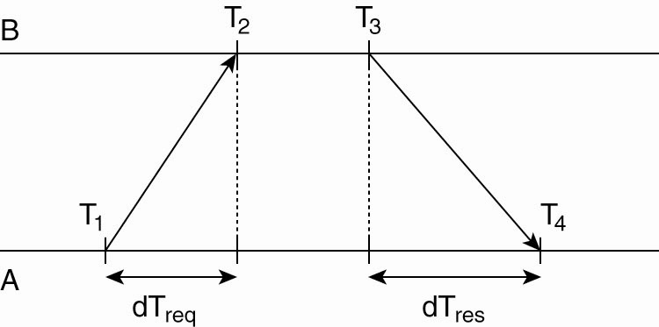
Network Time Protocol
Getting the current time from a time server

Slide 34
Logical clocks
Lamport’s logical clocks
Vector clocks

Slide 35
To order events across processes one approach is try to synchronize the clocks
Another approach is assign time stamps to events

Slide 36
Lamport’s Logical Clocks
First point: if two processes do not interact, then their clocks do not need to be synchronized – they can operate concurrently without fear of interfering with each other.
Second (critical) point: the processes have some agreement on the order in which certain events occur.
Lamport used these two observations to define the “happens-before” relation
often referred to within the context of Lamport’s Timestamps

Slide 37
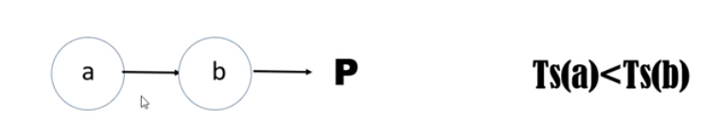
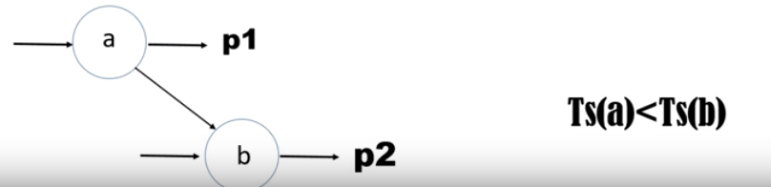
Happened Before Relation

Slide 38
Properties of Happened Before Relation
Transitive Relation
Causally ordered Relation
Concurrent Relation

Slide 39
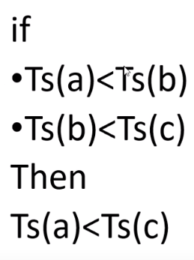
Transitive Relation

Slide 40
Causally ordered Relation
a->b
if a happens before b then
Change in event a, affects event b

Slide 41
Concurrent Relation
Neither a->b happening
nor b->a happening
a and b are happening in parallel
a|| b

Slide 42
Algorithm
Each process uses an integer local counter which is initialized to zero
The process increments its counter value when any event takes place
The counter value is assigned to the event as its time stamp
The send event carries its time stamp
For receive event counter is updated as max(local clock, msg ts)+1

Slide 43
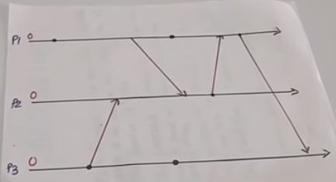
Lamport’s logical clock example

Slide 44
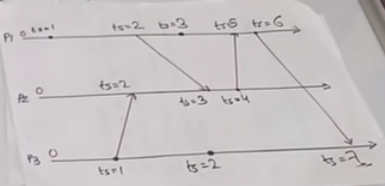
Lamport’s logical clock example

Slide 45
Vector clocks
Every process maintains a vector of events [e11,e2,e13,……….], [e21,e22,23,……], ……
If an event occurs in a process, then then time stamp of its own process will be incremented
If process receives any event, then time stamp will be updated as max{vector time stamps}

Slide 46
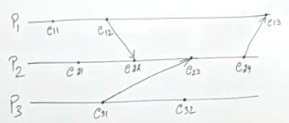
Example

Slide 47
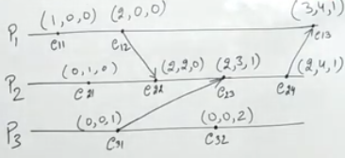

Slide 48
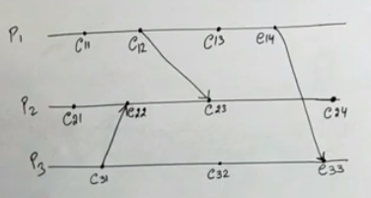
Example 2

Slide 49
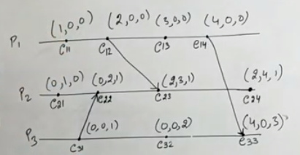

Slide 50
Mutual Exclusion
Non Token based Algorithm
Token based Algorithm

Slide 51
Token Based Algorithm
There is only one token available and who ever has that token is allowed to access the shared resource.
When finished, the token is passed on to a next process.
If a process having the token is not interested in accessing the resource, it simply passes it on .

Slide 52
properties
1. Depending on the how the processes are organized, they can fairly easily ensure that every process will get a chance at accessing the resource i.e they avoid starvation.
2.Deadlocks by which several processes are waiting for each other to proceed, can easily be avoided.
Drawback of token-based solutions when the token is lost, distributed procedure needs to be started to ensure that a new token is created, that it is also the only token.

Slide 53
Token Based Algorithm
Suzuki kasami Algorithm
Singhal heuristic Algorithm
Raymond tree Algorithm

Slide 54
Non Token Based Algorithm
a process wanting to access the resource first requires the permission of other processes

Slide 55
Non Token Based Algorithm
Lamport’s Algorithm
Ricart Agarwala Algorithm
Maekawa’s Algorithm

Slide 56
Centralized Algorithm
One process is elected as the coordinator.
Whenever a process wants to access a shared resource, it sends a request message to the coordinator stating which resource it wants to access and asking for permission.
If no other process is currently accessing that resource, the coordinator sends back a reply granting permission
When the reply arrives, the requesting process can go ahead.

Slide 57
Now suppose that another process, 2, asks for permission to access the resource.
The coordinator knows that a different process is already at the resource, so it cannot grant permission.
The exact method used to deny permission is system dependent.
The coordinator just refrains from replying, thus blocking process 2, which is waiting for a reply.
Alternatively, it could send a reply saying "permission denied." Either way, it queues the request from 2 for the time being and waits for more messages.

Slide 58
When process 1 is finished with the resource, it sends a message to the coordinator releasing its exclusive access.
The coordinator takes the first item off the queue of deferred requests and sends that process a grant message.
If the process was still blocked it unblocks and accesses the resource.
If an explicit message has already been sent denying permission, the process will have to poll for incoming traffic or block later.
Either way, when it sees the grant, it can go ahead as well.

Slide 59
The algorithm guarantees mutual exclusion
the coordinator only lets one process at a time to the resource.
It is also fair, since requests are granted in the order in which they are received.
No process ever waits forever (no starvation).
The scheme is easy to implement, too, and requires only three messages per use of resource (request, grant, release)

Slide 60
Limitations
The coordinator is a single point of failure, so if it crashes, the entire system may go down.
If processes normally block after making a request, they cannot distinguish a dead coordinator from "permission denied" since in both cases no message comes back.
In a large system, a single coordinator can become a performance bottleneck

Slide 61
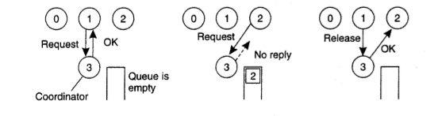

Slide 62
Decentralized Algorithm
their solution extends the central coordinator in the following way.
Each resource is assumed to be replicated n times.
Every replica has its own coordinator for controlling the access by concurrent processes.
whenever a process wants to access the resource, it will simply need to get a majority vote from 111 > nl2 coordinators.
Unlike in the centralized scheme, we assume that when a coordinator does not give permission to access a resource (which it will do when it had granted permission to another process), it will tell the requester.

Slide 63
This scheme makes the original centralized solution less vulnerable
to failures of a single coordinator.
when a coordinator crashes, it recovers quickly but will have forgotten any vote it gave before it crashed.
a coordinator resets itself at arbitrary moments.
a reset will make the coordinator forget that it had previously granted permission to some process to access the resource.
As a consequence, it may incorrectly grant this permission again to another process after its recovery.
Problem with this is if there are so many nodes competing to get access that eventually no one is able to get enough votes leaving the resource unused

Slide 64
A Distributed Algorithm
When a process wants to access a shared resource, it builds a message containing the name of the resource, its process number, and the current (logical) time.
It then sends the message to all other processes, including itself.
The sending of messages is assumed to be reliable
When a process receives a request message from another process, the action it takes depends on its own state with respect to the resource named in the message.
There are three different cases

Slide 65
1. If the receiver is not accessing the resource and does not want to access it, it sends back an OK message to the sender.
2. If the receiver already has access to the resource, it simply does not reply. Instead, it queues the request
3. If the receiver wants to access the resource as well but has not yet done so, it compares the timestamp of the incoming message with me. one contained in the message that it has sent everyone.
The lowest one wins. If the incoming message has a lower timestamp, the receiver sends back an OK message. If its own message has a lower timestamp, the receiver queues the incoming request and sends nothing.

Slide 66
After sending out requests asking permission, a process sits back and waits until everyone else has given permission.
As soon as all the permissions are in, it may go ahead.
When it is finished, it sends OK messages to all processes on its queue and deletes them all from the queue.

Slide 67
Limitations
the single point of failure has been replaced by n points of failure. If any process crashes, it will fail to respond to requests.
Another problem with this algorithm is that either a multicast communication primitive must be used. or each process must maintain the group membership list itself, including processes entering the group, leaving the group, and crashing.
all requests can lead to a bottleneck
this algorithm is slower, more complicated, more expensive, and less robust that the original centralized one

Slide 68
A Token Ring Algorithm

Slide 69
Election Algorithms
Bully Algorithm
Ring Algorithm

